Slide 1
Distributed System Research Laboratory
Technical University of Cluj-Napoca
Faculty of Computer Science and Automation
Department of Computer Science
Data reliability using decentralized systems
Student Ionuț-Dan Matiș
Supervisor S. L. Dr. Eng. Claudia-Daniela Pop
Cluj-Napoca, Romania
Notes:
Hello, my name is Ionut Matis and here is my license thesis name data reliability using decentralized systems

Slide 2
Contents
Context and motivation
Problem definition
Objective
Related work
Solution
Implementation Details
Experimental Results
Conclusion
Bibliography
2
Notes:
Here is the table of contents

Slide 3
Context and Motivation
Context
Internet and information growth
Everyone has access to it
Motivation
Reliability of information
How can someone inform himself or herself correctly?
Notes:
Over the last decades, the internet infrastructure has increased dramatically and so has done the amount of information which was created and processed
Nowadays everyone has access to internet & can inform themselves about various topics
With this, a problem has arisen. How can someone validate the integrity of the information he is reading?
One solution would be reading from a single source of information and accept it as true, but what if that source of information becomes unreliable?
Another solution involves reading from multiple sources, but this may become time consuming and impractical

Slide 4
Problem definition
Centralized systems
a single authority has all power
there exists a point of failure
Decentralized systems
built upon a set of rules (consensus)
equal trustless peers
Notes:
The main issue regarding the actual systems is the fact that they are centralized, meaning that a single authority makes all decisions
This is a problem and can represent a point of failure. If the central authority is taken down or it starts spreading unreliable information, the system is compromised
On the other hand, decentralized systems are built upon a set of rules, and there is no central authority. The system is composed of equal peers that do not trust each other.

Slide 5
Objectives
Main Objective
Implement a system able to detect data plagiarism and corruption using and extending two known decentralized systems (Ethereum & IPFS)
Secondary Objectives
Allow users to version (edit) their uploaded data
Compare the cost of storing data in a decentralized manner
Notes:
The main objective is to implement a system able to detect data plagiarism and corruption using and extending two known decentralized systems (Ethereum & IPFS)
In terms of secondary objectives, the system should allow users to version (edit) their uploaded data. A comparison regarding the cost of storing data in a decentralized manner will be presented

Slide 6
Related work
Solution | Description | Advantages | Disadvantages
Store data directly on blockchain | adds data to the blockchain’s transactions | simple to implement | very expensive
Acronys notary system | stores data on separate system & link it in ethereum | cheap to implement | rely on the logic and system of a central authority
IPFS-Blockchain-Based Authenticity of Online Publications | uses Ethereum and IPFS to store online book publications | completely decentralized | there is no check for data corruption
Notes:
In terms of related work, there are some systems that try to store data directly on blockchain. This is not a good idea, as cost can get very high. We will see that when looking at the results section
Acronis Notary System stores the data on their separate system and then saves a link to that data in blockchain
The last example is a paper published two years ago and presents an application composed of the same two decentralized system as this one. The difference is the fact that their system involves multiple actors and their use case is applied to online books publication and do not have data corruption detection.

Slide 7
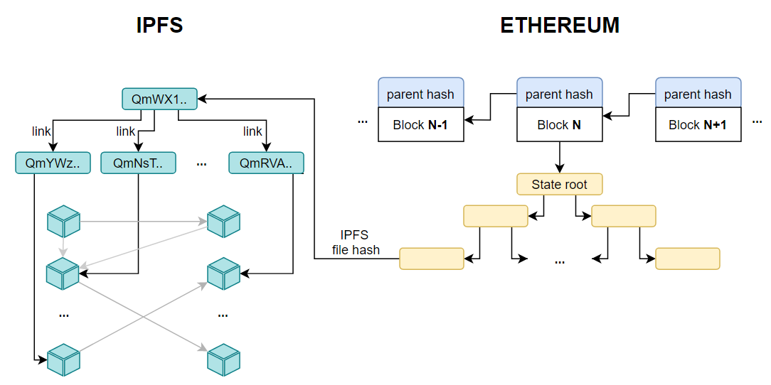
Solution
Combination of two systems
Notes:
The solution consists of the combination of two decentralized systems
The first one is ethereum blockchain. You can think of it as a growing database that contains transactions and code that can be run. This database is copied on all nodes that run the protocol. It is very expensive to store large amounts of data in it therefore we need
The second system is Interplanetary File System (IPFS) which stores file in a decentralized manner and allows the accessing of files through their hashed content.

Slide 8
Solution – data upload
Users uploads their data (from their computer) into DRDS
Data is sent to IPFS, we receive a hash
If the file is greater than 256KB, it will be split into links, each having its own hash and containing a part of the larger file
The main hash will hold references to its links
The hash is stored on blockchain and can be retrieved in the future
Notes:
This is how it works.

Slide 9
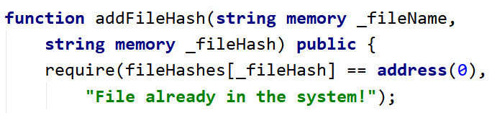
Solution - plagiarism detection
implemented at Smart contract level, storing all hashes together with user’s address
when a file is added / edited, we check it
Notes:
We search in the system for the hash. If we find it, a plagiarism is detected

Slide 10
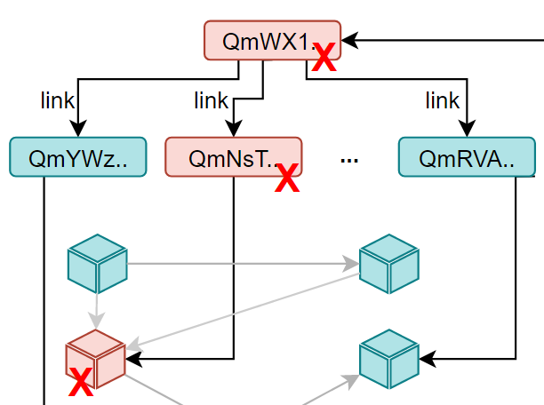
Solution - corruption detection
Uploaded files are stored on a remote, trustless IPFS node and an attacker could alter them
Notes:
We will navigate through each link in IPFS and try to access its data. If we fail, the link is corrupt. The other links do not depend on each other and can still be valid

Slide 11

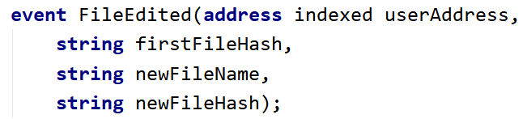
Solution - data versioning
implemented at Smart contract level
emit events which are stored on contract and can be queried later to retrieve all versions
Notes:
We care about the first and latest version of a file
Navigating through this series of events we can find all edits that were performed

Slide 12
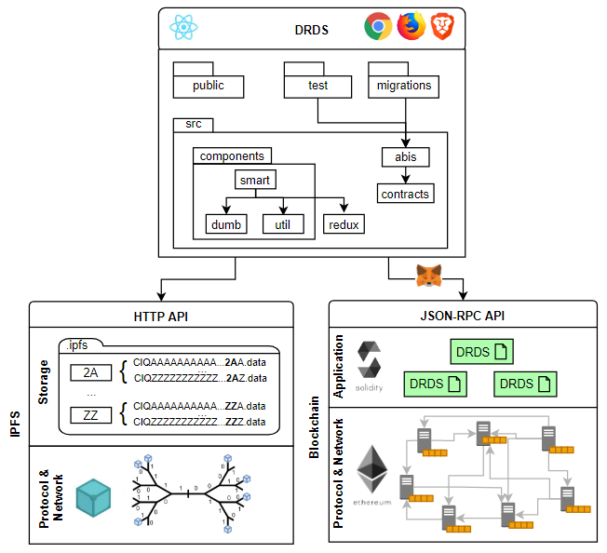
Implementation - diagram
Notes:
The implementation consist of three main modules
DRDS module: it is the frontend part developed in react. Runs in a browser and communicates through specific apis to the other modules
Blockchain module, which is separated in two: the application part contains the DRDS smart contract and the network part presents the topology of the nodes
IPFS module, which acts as a database: it has a special way of storing data (in folders) based on the next to last 2 characters of the ipfs hash
The network based on kademlia distributed hash table

Slide 13
Implementation - technologies
Metamask – it is a gateway
Handles the accounts which interact with the blockchain
Handles the transactions
Ganache
Ethereum blockchain emulator
Has its own test accounts and network
Notes:
Metamask: allows the browser application to communicate with the blockchain
manages user ethereum accounts
handles the transactions originated from the application (by signing them)
Ganache: it is an ethereum blockchain emulator
provides us with ten accounts out of the box
has its own network and runs on a specific port: 75 45

Slide 14
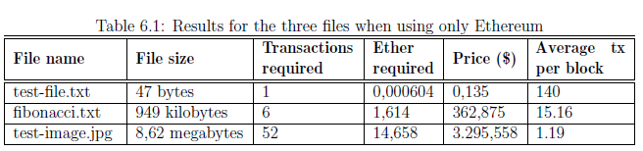
Experimental results
Performed the tests on three files of different sizes
We did not take into account transaction fees
Storing data solely on blockchain
Notes:
Previously we discussed why blockchain cannot be used to store large amounts of data. here it is why
tx fee: amount we pay the miner to include our tx in the block
Gas price, ether price, gas limit

Slide 15
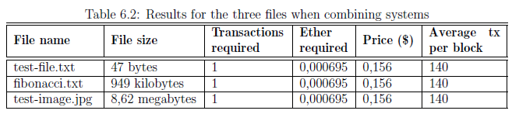
Experimental results
Storing data on Ethereum and IPFS
We store just the reference (hash) of the file
Notes:
Much cheaper, as we store the same amount of info (ipfs hash)
The average number of transactions also remains constant

Slide 16
Conclusions
Overall system can prove to be a great aid in managing data reliability
The cost of storing data in a decentralized manner remains relatively low when combining two systems (we have the best of both worlds)

Slide 17
Bibliography
[1] Gavin Wood, Andreas M. Antonopoulos, Mastering Ethereum: Building Smart Contracts and DApps O'Reilly Media, 2018, vol. 1.
[2] Juan Benet, Ipfs - content addressed, versioned, p2p file system, 2019, draft 3
[3] Nishara Nizamuddin, Haya Hasan, Khaled Salah, Ipfs-blockchain-based authenticity of online publications, 2018.
[4] Acronis International GmbH, Acronis notary: a new way to prove data authenticity via blockchain, 2016

Slide 18
Thank you for your attention!

